Slide 1
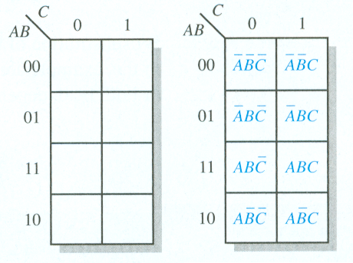
Karnaugh MaP
3-Variable Karnaugh Map

Slide 2
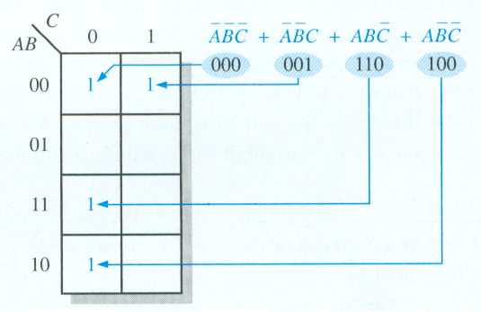
The Karnaugh Map

Slide 3
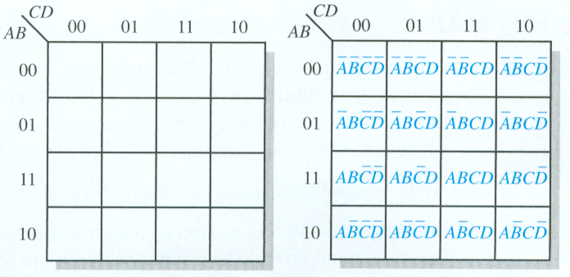
The Karnaugh Map
4-Variable Karnaugh Map

Slide 4
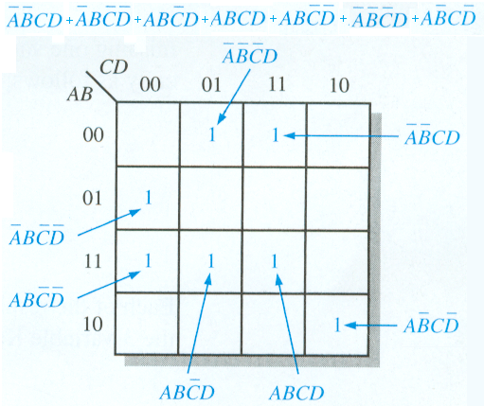
4-Variable Example

Slide 5


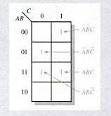

Slide 6

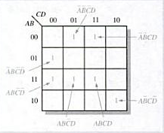

Slide 7


Slide 8

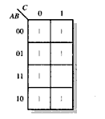
solution

Slide 9


